Slide 1
zekeLabs
Learning made Simpler ! www.zekeLabs.com

Slide 2
Docker Dockerfile and Image Mgmt

Slide 3
Docker Terminology
Dockerfile
Starting point of the dockerization process.
Details the configuration of an application and specifies resources needed
Tells the image builder (eg. Jenkins) what the image should look like.
Docker Registries
Public or private stores from which you upload/download images
Can be done on docker hub which is docker’s version of github
Distribution component of docker

Slide 4
Docker Terminology
Docker Engine
The container runtime with built in orchestration, networking and security that installs on any physical, virtual (VM) or cloud host (AWS, Azure, Google Cloud Enterprise etc).
The lightweight runtime installs directly on the host OS i.e Windows Server 2016, Ubuntu, CentOS, RHEL OpenSUSE.

Slide 5
Docker Terminology …
Containers are built from a Docker image.
The Docker image uses union filesystems and is comprised of multiple layers.
“docker run” command spins up a container from the defined image
Commands include creating new containers, scaling existing containers, stopping, removing etc.

Slide 6
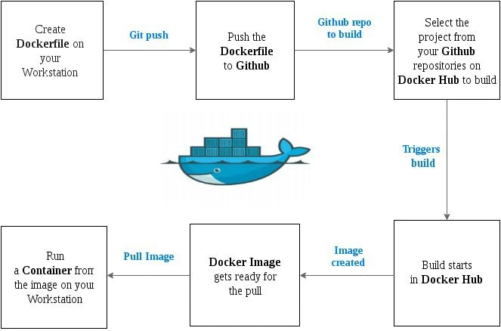
Docker Lifecycle

Slide 7
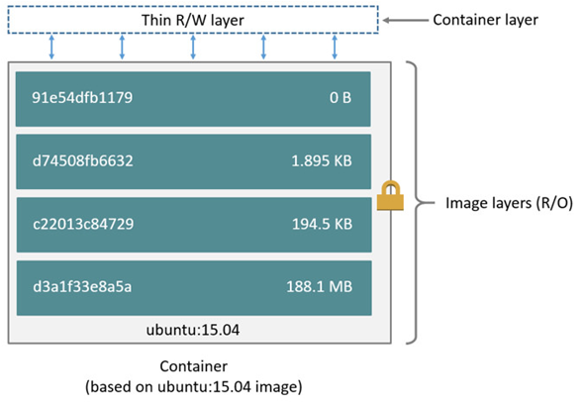
Image and Container

Slide 8
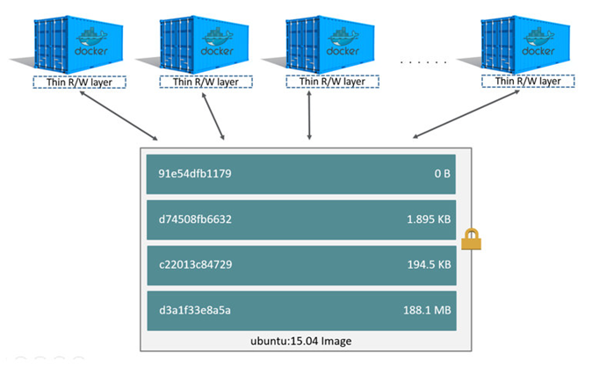
Multiple Containers using same image

Slide 9
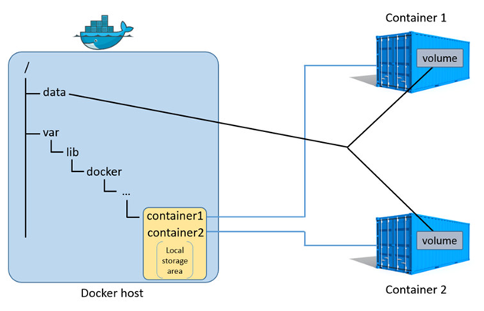
Sharing Storage Space

Slide 10
Docker Commands

Slide 11
Lifecycle
docker create | Creates a container but does not start it
docker rename | Allows the container to be renamed
docker run | Creates and starts a container in one operation
docker rm | Deletes a container
docker run –rm | Removes container when stopped
docker rm –v | Removes volumes associated with container
docker run --log-driver=syslog | Runs Docker with custom log driver

Slide 12
Starting and Stopping
docker start | Starts a container, so it is running
docker stop | Stops a running container
docker restart | Stops and starts a container
docker pause | Pauses a running container, “freezing” it in place
docker unpause | Unpauses a running container
docker wait | Blocks until running container stops
docker kill | Sends a SIGKILL to a running container
docker attach | Connects to a running container

Slide 13
Information on Docker Containers, Processes and Performance
docker ps | Shows running containers
docker logs | Gets logs from container
docker inspect | Looks at all the info on a container
docker events | Gets events from container
docker port | Shows public facing port of container
docker top | Shows running processes in container
docker stats | Shows containers’ resource usage statistics
docker diff | Shows changed files in the container’s filesystem

Slide 14
Image Managem
docker images | Shows all images
docker import | Creates an image from a tarball
docker build | Creates image from Dockerfile
docker commit | Creates image from a container, pausing it temporarily if it is running
docker rmi | Removes an image

Slide 15
Images
docker load | Loads an image from a tar archive as STDIN, Including images and tags
docker save | Saves an image to a tar archive stream to STDOUT with all parent layers, tags and versions.
docker history | Shows history of image
docker tag | Tags an image to a name (local or registry)
docker rmi | Removes an image

Slide 16
Import / Export, Execution
docker cp | Copies files or folders between a container and the local filesystem
docker export | Turns container filesystem into tarball archive stream to STDOUT
docker exec | Executes a command in container

Slide 17
Dockerfile

Slide 18
Dockerfile
FROM python:2.7
COPY . /app
WORKDIR /app
CMD python app.py
The FROM statement
The COPY command adds some files from your Docker client’s current directory.
The WORKDIR changes directory inside the container.
The CMD command specifies what command to run within the container.

Slide 19
Sections/Directives in a Dockerfile
FROM | Sets the base image for subsequent instructions. Starts out by creating a layer from the ubuntu:15.10 image.
MAINTAINER | Sets the Author field of the generated images
RUN | Executes any commands in a new layer on top of the current image and commits the results
CMD | Provides defaults for an executing container

Slide 20
Sections/Directives in a Dockerfile
EXPOSE | Informs Docker that the container listens on the specified network ports at runtime; does not make ports accessible
ENV | Sets environment variables
ADD | Copies new files, directories or remote file to container; invalidates caches; avoid ADD and use COPY instead
COPY | Copies new files or directories to container

Slide 21
Sections/Directives in a Dockerfile
ENTRYPOINT | Configures a container that will run as an executable
VOLUME | Creates a mount point for externally-mounted volumes or other containers
USER | Sets the username for following RUN/CMD/ENTRYPOINT commands
WORKDIR | Sets the working directory

Slide 22
Sections/Directives in a Dockerfile
ARG | Defines a build-time variable
ONBUILD | Adds a trigger instruction when the image is used as the base for another build
STOPSIGNAL | Sets the system call signal that will be sent to the container to exit
LABEL | Apply key/value metadata to your images, containers, or daemons

Slide 23
ENV
The ENV instruction sets the environment variable <key> to the value <value>
Two forms:
ENV companyName=“zekeLabs” location=“bangalore”
ENV company zekeLabs tech pvt ltd
Environment variables can be replaced during docker run:
docker run --env <key>=<value>

Slide 24
RUN
The RUN instruction will execute any commands in a new layer on top of the current image and commit the results. The resulting committed image will be used for the next step in the Dockerfile.
Two forms:
RUN <command> (shell form, the command is run in a /bin/sh -c on Linux)
RUN ["executable", "param1", "param2"] (exec form)
Environment variables can be replaced during docker run:
docker run --env <key>=<value>

Slide 25
ENTRYPOINT
ENTRYPOINT has two forms:
ENTRYPOINT ["executable", "param1", "param2"] (exec form, preferred)
ENTRYPOINT command param1 param2 (shell form)
Command line arguments to docker run <image> will be appended after all elements in an exec form ENTRYPOINT, and will override all elements specified using CMD.

Slide 26
CMD
CMD has three forms:
CMD ["executable","param1","param2"] (exec form, this is the preferred form)
CMD ["param1","param2"] (as default parameters to ENTRYPOINT)
CMD command param1 param2 (shell form)
The main purpose of a CMD is to provide defaults for an executing container.
Could be default arguments for ENTRYPOINT or default command

Slide 27
CMD and ENTRYPOINT
Both CMD and ENTRYPOINT instructions define what command gets executed when running a container.
Dockerfile should specify at least one of CMD or ENTRYPOINT commands.
ENTRYPOINT should be defined when using the container as an executable.
CMD should be used as a way of defining default arguments for an ENTRYPOINT command or for executing an ad-hoc command in a container.
CMD will be overridden when running the container with alternative arguments.

Slide 28
EXPOSE
The EXPOSE instruction informs Docker that the container listens on the specified network ports at runtime.
The EXPOSE instruction does not actually publish the port.
It functions as a type of documentation between the person who builds the image and the person who runs the container, about which ports are intended to be published.
To actually publish the port when running the container, use the -p flag on docker run to publish and map one or more ports.
EXPOSE 80/tcp
EXPOSE 80/udp
docker run -p 80:80/tcp -p 80:80/udp ...

Slide 29
THANK YOU
Let us know how can we help your organization to Upskill the employees to stay updated in the ever-evolving IT Industry.
Get in touch:
www.zekeLabs.com | +91-8095465880 | info@zekeLabs.com
Visit : www.zekeLabs.com for more details

